Slide 1
Mapping Geospatial Data:
Google My Maps
Taught By: Kasya O’Connor Grant
INTL1101 Globalization and International Affairs
Prof. Youly Diamanti-Karanou
Fall 2023
Feel free to ask questions at any point during the presentation!
Notes:
20 minutes, with 5 or 10 for questions

Slide 2
Workshop Agenda
Learn about Google My Maps as a mode of conveying data and content
Discuss best practices and questions to consider before creating your map in Google My Maps
Explore sample maps
Outline steps for using Google My Maps
Start building!
Slides, handouts, and data available at

Slide 3
Workshop Objectives
Articulate particular choices you will make when using a map to convey information
Follow a step-by-step guide for creating, saving, and publishing maps using Google My Maps
Upload data into Google My Maps, including location information, images, and text
Navigate Google’s map markers and location-finding system

Slide 4
What are different uses for maps?
Maps are powerful tools for conveying geospatial information
Well-made maps can quickly and easily give content and context, but poorly made maps can be misleading
How do you use maps in your everyday life?
How does a subway map compare to a Google map?
What are these maps doing? How do they shape your expectations and experiences?

Slide 5
How do maps represent reality?
Maps certainly reflect the intention of the map-maker, but maps are also inherently limited.
Boston is as much a human idea as a physical space, and thus maps both represent and create reality. [Laura Herbert, “What Do Maps Really Do?”]
The simplicity and clarity of maps is deceiving, and we should question it. But the artificial clarity is necessary for the map to be useful. Think of the maps that are useful to you: they filter out the information that is less relevant to what you’re using the map for.
Notes:
Imagine a map that was so precise and comprehensive that it left nothing out. In a metaphorical sense, the map with the most exact representation of Boston, point for point, would be so large that it covers the entire city. Maps are limited and contestable, but they’re useful, and that’s why we’re learning how to make them.
Refer people to Jorge Luis Borges, “On Exactitude in Science” (1946): “…In that Empire, the Art of Cartography attained such Perfection that the map of a single Province occupied the entirety of a City, and the map of the Empire, the entirety of a Province. In time, those Unconscionable Maps no longer satisfied, and the Cartographers Guilds struck a Map of the Empire whose size was that of the Empire, and which coincided point for point with it. The following Generations, who were not so fond of the Study of Cartography as their Forebears had been, saw that that vast Map was Useless, and not without some Pitilessness was it, that they delivered it up to the Inclemencies of Sun and Winters.”

Slide 6
Questions for critiquing maps
From Shannon Mattern, professor of anthropology at The New School (“Critiquing Maps II”):
What’s its subject?
What is its “message” or “argument” or purpose?
How was the map made?
What’s its geographic/spatial area?
When is this map?
Who made this map? Editorial choices?
Who is/are the map’s audiences?
What are the map’s materiality and form?

Slide 7
Example Projects Using Google My Maps
“US National Parks”: uses a mix of textual, image, and geo-location data to provide content and context about US National Parks
“Freedom Trail Boston”: uses a mix of lines, geo-spatial points, texts, and images to map the route of the Freedom Trail in Boston
“Davis Square Somerville”: maps the businesses of Davis Square, using different icons to demonstrate various types of businesses

Slide 8
Activity: Explore Boston’s Black Heritage Trail
Explore this sample map of Boston’s Black Heritage Trail. This map makes use of several Google My Maps features, including color coding, styling of icons and basemap, layers, points, lines, and polygons.
We will learn how to add these features to our own maps, including how to:
Add and style points, lines, and polygons
Add images, descriptions, and links
Utilize layers and basemaps

Slide 9
Analysis of Examples
Look through the examples, particularly the map of the Black Heritage Trail, and think about how they use geospatial layouts to present information.
Make some notes about how you interacted with these maps.
Can these techniques be applied to your own mapping goals?
What worked best? What didn’t work for you? What do you want to try on your own?

Slide 10

Create a map with Google My Maps
Go to https://www.google.com/mymaps
Sign in through Google
Click “Create a New Map”
Once you have created your map, it will be there for you to work on
Name your project and give it a description

Slide 11
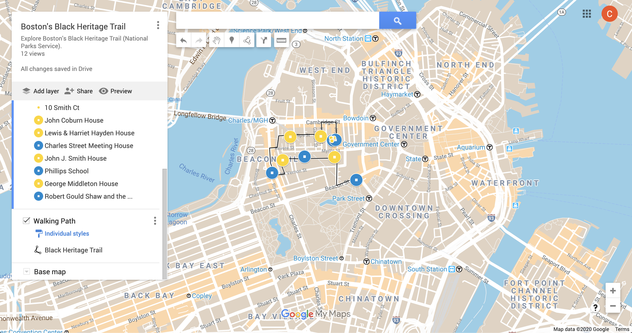
Example Projects Using Maps to Tell Stories
Map title and map description
Search for locations using their addresses
Add and move points, lines, and polygons
Undo and redo
Zoom in and out
Change basemap
Add new layers and preview the finished product

Slide 12
Selecting Your Basemap
To change your basemap, go to the bottom of the left-hand column and click “Base Map.” Google provides you with a variety of options to choose from.
Basemaps can help:
Situate the map a particular context
Make certain content easier or more difficult to read
What other impacts and implications can you think of?

Slide 13
Map Markers
Map markers are the different points on your map. You can place markers using coordinates or addresses, or add them manually.
Each marker can contain:
Name and description
Street address
Latitude/longitude geospatial coordinates
Customizable icon and color
Media: images, videos, and links

Slide 14
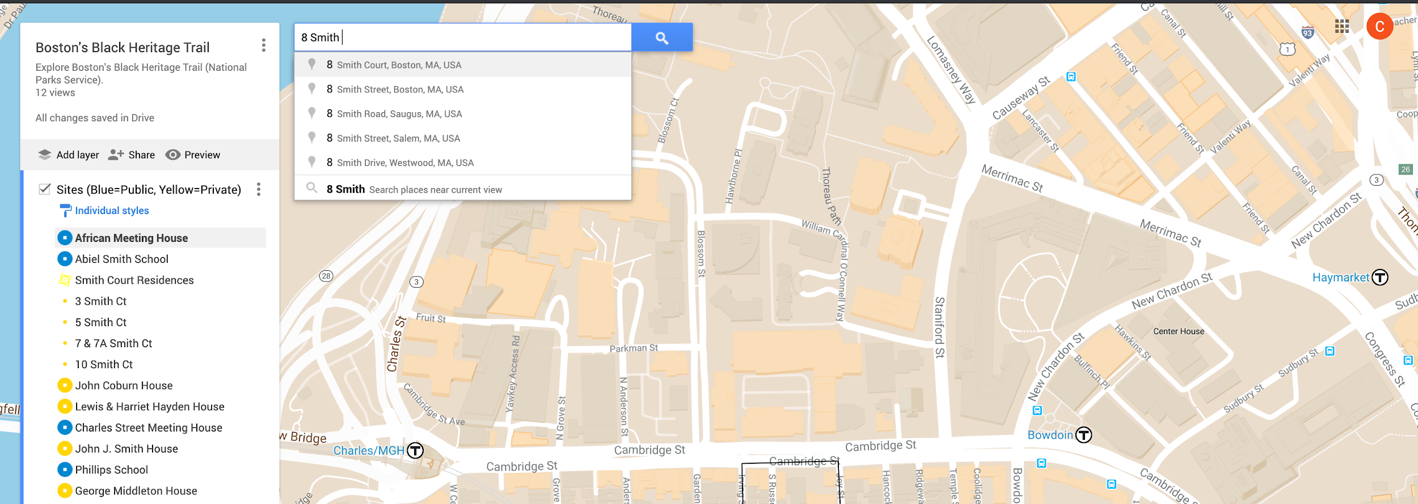
Add A Location
Search for the location you want and select "Add to Map."
Google My Maps does not always recognize place names; you might need to look up the address or location instead
If you cannot find the address for a location, you can select the marker icon and click on the spot where you wish to add the marker

Slide 15
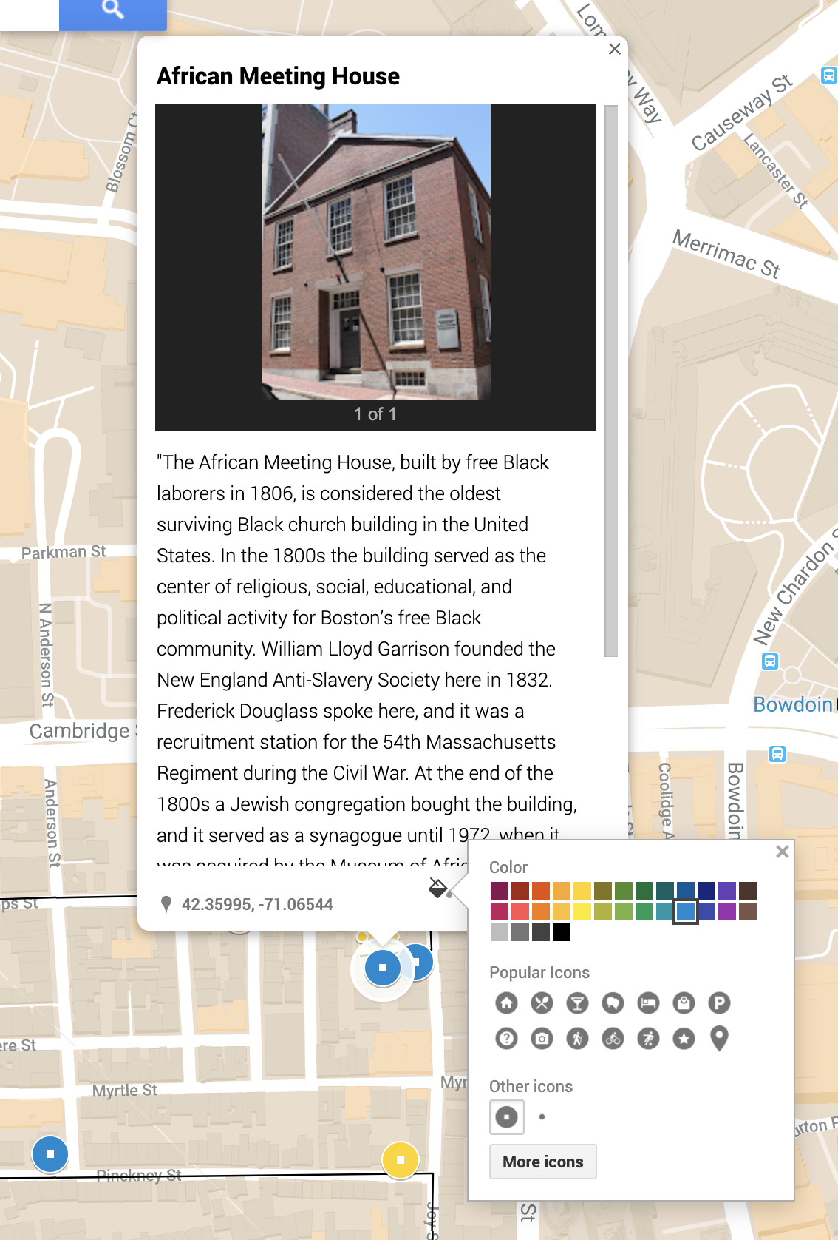
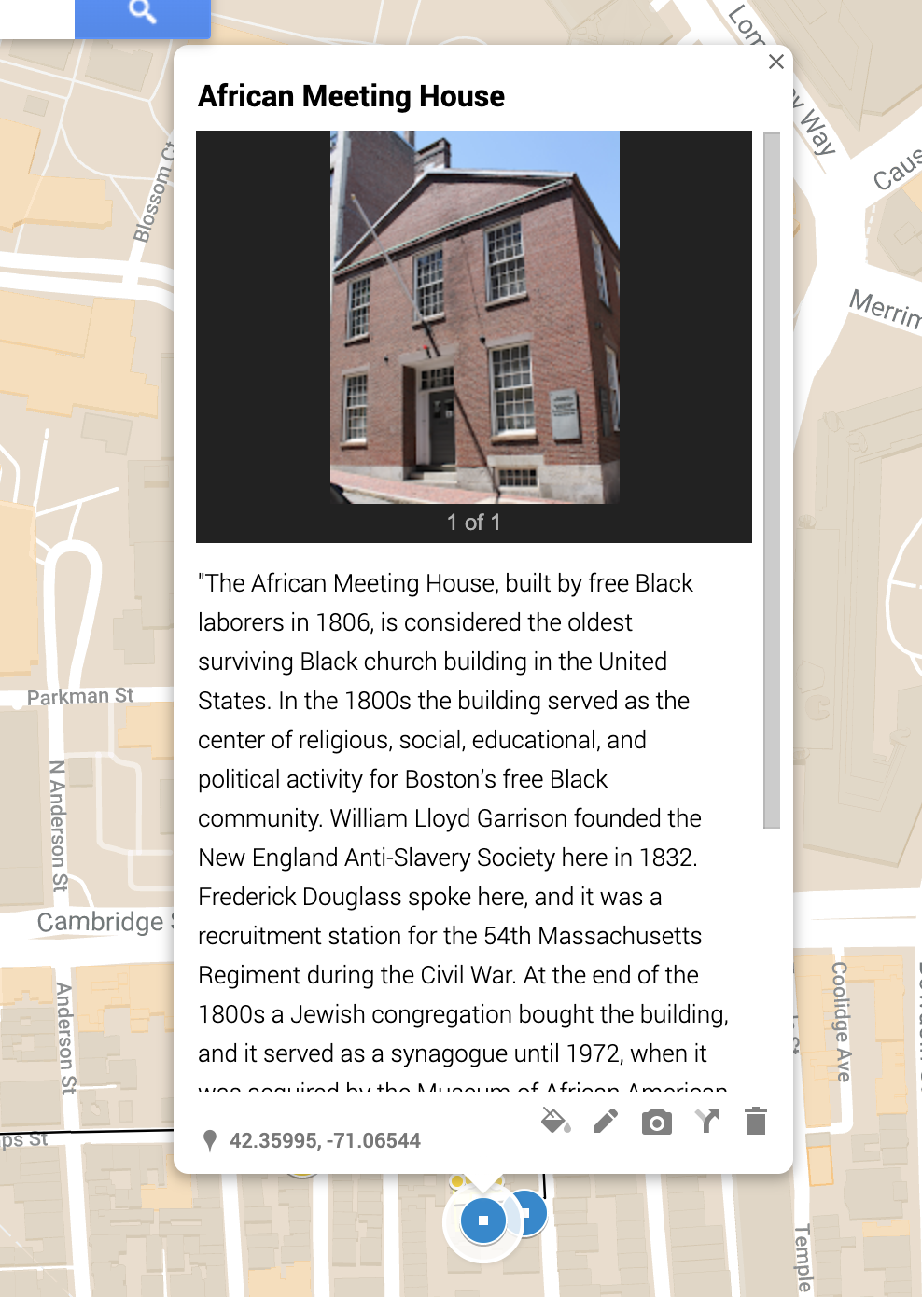
Add More Data to Markers
Tools, left to right: Style, Edit title and description, Add images/video, Delete marker line or polygon
For all markers, you can add a title, description, images, videos, links, and customizable color.
You can change the color and icon of the marker.

Slide 16
Lines and Polygons
Google My Maps can also add lines and polygons to your map. Lines and polygons use fixed points on the map that you select to visualize key information.
Lines can demonstrate routes and directions. Lines are easiest to add when you’re representing the shape of a route that presently exists.
Polygons can demonstrate towns and neighborhoods. Polygons are best for representing the shape of a historic area whose boundaries have since changed.

Slide 17
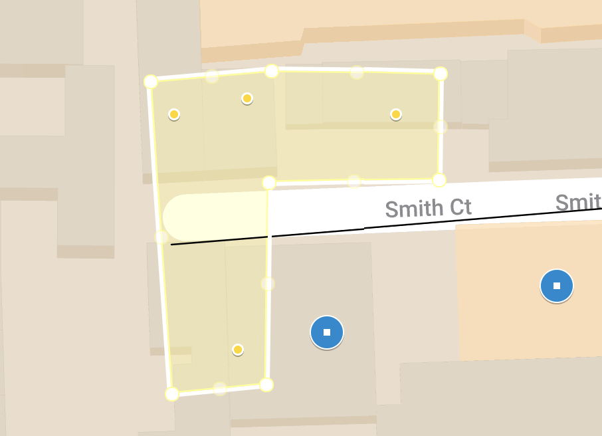
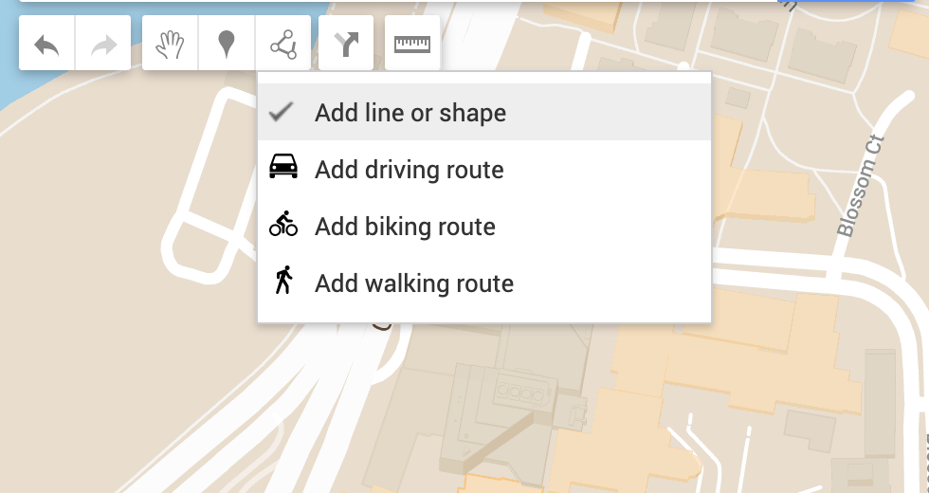
Add Lines and Polygons
Click “Add line or shape”
For polygons, click where you want to start drawing, click each corner or bend of the line, and click back on the first point to finish the shape.
For lines, click where you want to start drawing and then click each corner or bend of the line; double click when you are done with the line.

Slide 18
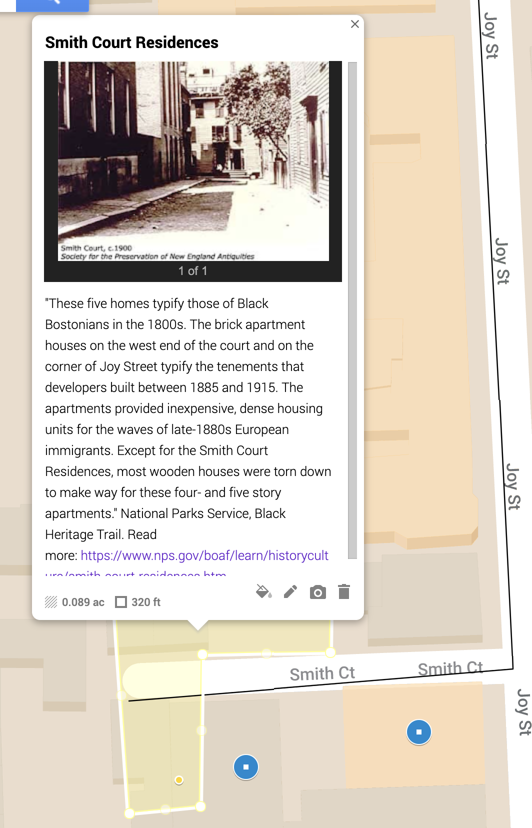
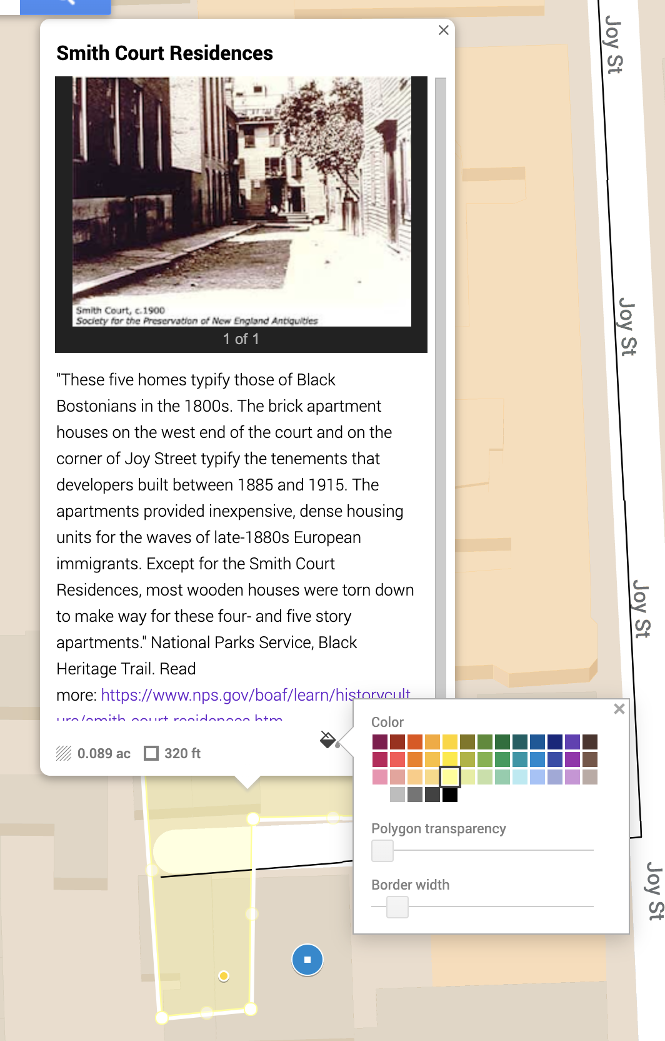
Add More Data to Lines and Polygons
Tools, left to right: Style, Edit title and description, Add images/video, Delete line or polygon
For lines and polygons the color, transparency, and width can be customized.
For all lines and polygons, you can add a title, description, images, videos, and links.

Slide 19
Layers
Layers allow you to sort/filter your geospatial information into different groups. All of your markers, lines, and polygons will be placed into an “Untitled Layer,” so always make sure to title the layer even if you will only have one.
Individual layers can be turned on and off.
Layers can be exported individually as KML (a markup language for expressing geographic annotation) to view in Google Earth
To add a new layer, click “Add Layer”
Title the layer
Add markers, lines, or polygons!

Slide 20
Building your project
For this project, you can choose to map a number of different options related to African American history and literature, two of them suggested below. Or, you might have other ideas!
You might start from the Cromwell map and select some of the points there to represent in Google Maps, thinking about how the information changes when placed on a contemporary navigational map of the city.
You could also add more information to the data from Cromwell, such as looking up the estate valuations of some of the “Black” houses.
You could map historical copies of the Walker and Stewart texts and compare those with the locations of ports and stops on the railroad, or map information about the review and circulation of these texts.

Slide 21
Get started!
If you already know what you want to do for your mapping project, go ahead and get started on that in class.
If you're still figuring things out, just try to add a few points, lines, and polygons—as well as some descriptions and images. The Cromwell map would be a good place to start, if you don't already have something you want to map.
This is just to give you a bit of practice and a chance to try out Google My Maps.

Slide 22
Discussion
How do you think differently about these locations when they are in a Google My Maps format?
What was difficult or easy about this platform?
What was interesting about seeing your data presented in a Google My Maps format? Are you able to identify any patterns or new ways of thinking about your data?

Slide 23
Thank you!
If you have any questions, contact us at: nulab.info@gmail.com
Taught by Kasya O’Connor Grant
Digital Integration Teaching Initiative
NULab Research Fellow
Slides, handouts, and data available at
Schedule an appointment with us! https://calendly.com/diti-nu

